Slide 1


Foundations of
Scientific Computing
(SciComp 101)
Dave Biersach
dbiersach@bnl.gov
Session 02
Python Fundamentals

Slide 2
Session 02 – Goals
Review mathematical operators (PEMDAS) in Python
Declare a variable using a built-in data type
Review mathematical operators and precedence in Python
Display the values of variables in the output terminal using formatted strings and print format specifiers
Learn about Python Enhancement Proposals (PEPs)
Use Ruff to enforce the code format standards in PEP 8
Create a for loop to enumerate over a range of numbers
Convert Temperatures from Fahrenheit to Celsius

Slide 3
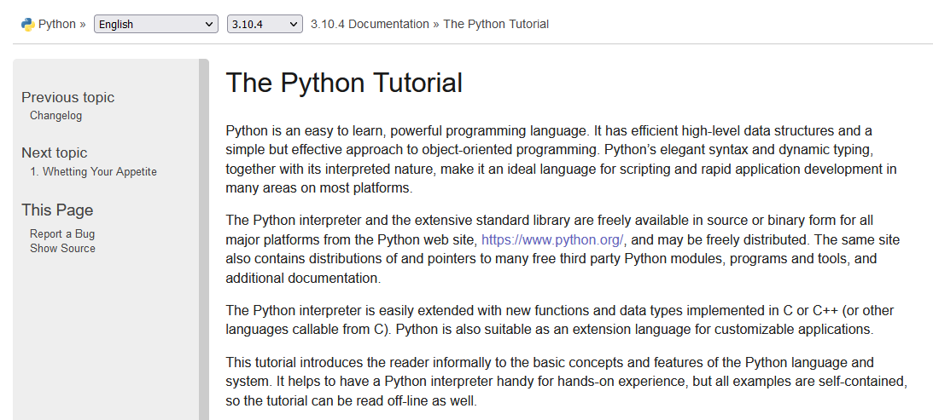
The Python Tutorial
https://docs.python.org/3/tutorial

Slide 4
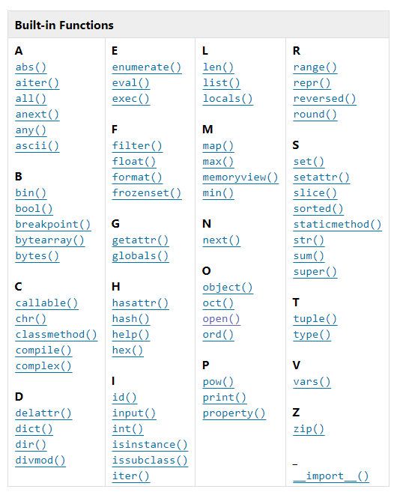
Python’s Built-in Functions
https://docs.python.org/3/library/functions.html

Slide 5
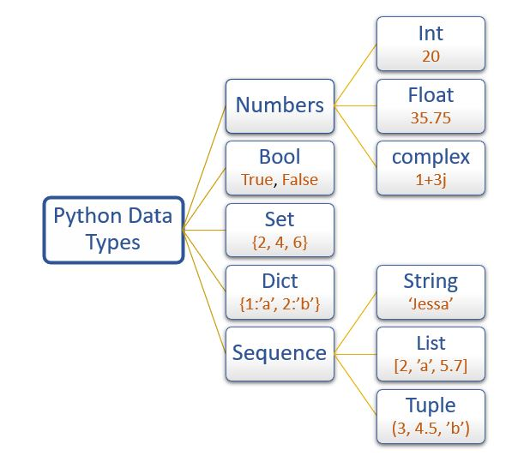
Python’s Built-in Data Types
Only
sequence types support indexed [] access
But you can use enumerate() with all of these data types

Slide 6
Mathematical Operators
Python operators obey normal PEMDAS precedence
Expressions are evaluated left to right in your source code
Use parentheses to override the order of operations
Use a single equal sign = to assign a value to a variable
Use double equal signs == to test for equality
Use * for multiplication
Use double asterisks ** for exponentiation
Use / for floating point division
Use // for integer (floor, aka “round down”) division

Slide 7
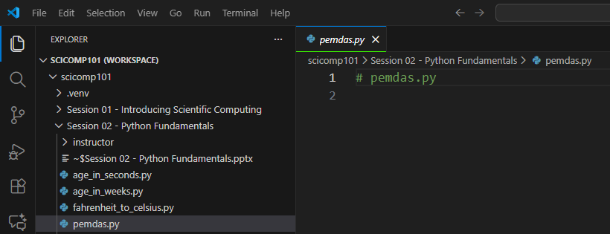
Open pemdas.py

Slide 8
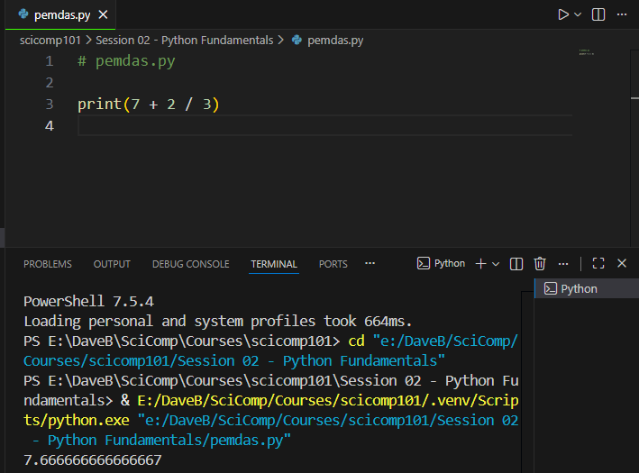
Edit & Run pemdas.py
You must type in this code
Type each statement and run the program when indicated

Slide 9
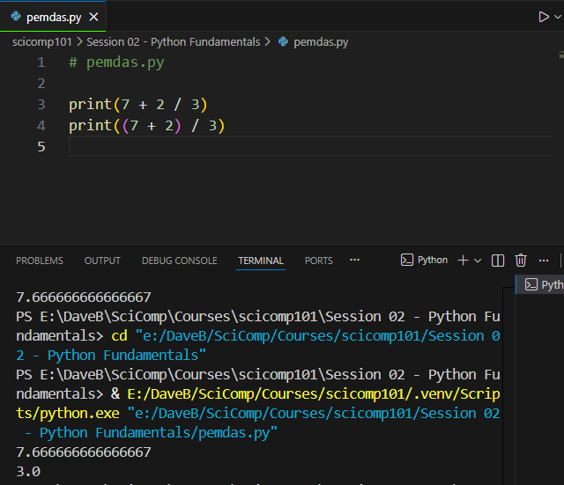
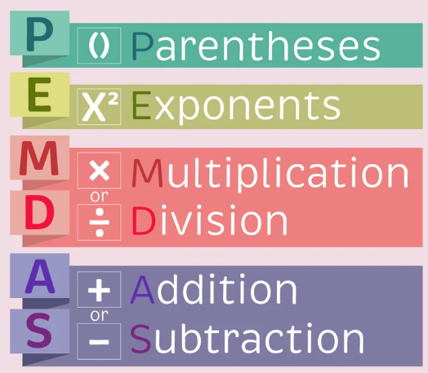
Edit then Run pemdas.py
You must type in this code

Slide 10
Identifiers
Identifiers are just names – everything in code has a name
Names must be < 64 chars in length
They can include upper- or lower-case letters and numbers
Identifiers must start with a letter and cannot contain spaces!
Three types of identifier “casing”
CamelCaseEachWord
camelCaseEachWord
all lower_case with underscores
Identifiers in Python are case sensitive!!
x is not the same as X
Never create ALLCAPS identifiers
(first letter is Capitalized)
(first letter is not capitalized)
(Snake case in Python!)
✓

Slide 11
Variable Types
Variables store data in memory to be used later
Variables can be called whatever you want
Pick variable names that mean something to a human
Use snake_case (all lower case, underscores to break words)
Python supports many built-in data types for variables:
int = Stores integers only
float = Stores Real numbers with 15 digits of precision
bool = Stores True or False (Boolean logic, uppercase T/F)
str = Stores zero or more letters & numbers (a string)
Python mostly “infers” the type of a variable (0 vs. 0.0)

Slide 12


Displaying Variables
The print() function is used to display the value of variables
When running inside VS Code, the output will show up in the Terminal window below your source code
String literals must be enclosed in double quotation marks

Slide 13
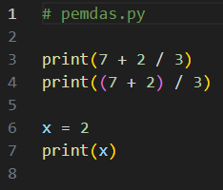

Edit then Run pemdas.py
You must type in this code
①
②
③

Slide 14
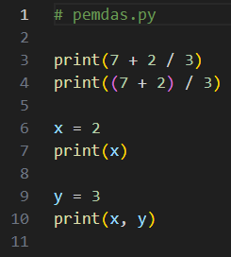

Edit then Run pemdas.py
You must type in this code
①
②
You can display multiple variables in a single print() statement
By default, Python will put a space between the values
③

Slide 15
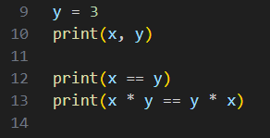
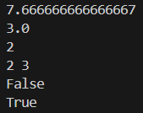


Edit then Run pemdas.py
You must type in this code
$$x=2$$
①
$$y=3$$
③
In Python, we test for equality using double equal signs
Multiplication is commutative
②
④

Slide 16
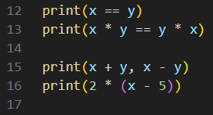

Edit then Run pemdas.py
You must type in this code
$$x=2$$
①
$$y=3$$
③
Parentheses override the regular order of operations
Subtraction is NOT commutative
②
④

Slide 17
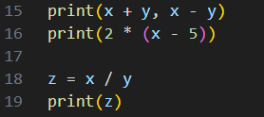

Edit then Run pemdas.py
You must type in this code
$$x=2$$
①
$$y=3$$
②
Expressions (formulas) don't need any numbers per se; they can also reference other identifiers (variables)
③

Slide 18
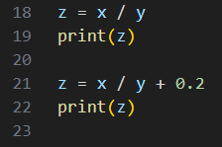

Edit then Run pemdas.py
You must type in this code
$$x=2$$
①
$$y=3$$
②
③
Division before Addition

Slide 19
Displaying Variables
Within a print() statement, Python can substitute a variable's value into a placeholder
To make a placeholder (aka a replacement field) you enclose the variable name between curly braces {}
Substituting a variable's actual value into its replacement field is called string interpolation
Placeholders can also contain format specifiers
You can specify the number of digits to the right of the decimal, etc.
You can specify left/right/center justification, column width, etc.

Slide 20

print() and f-strings
Placing a lowercase f before the first quote in a print() statement indicates you will use some placeholders
A placeholder contains the variable's name sandwiched between curly braces {}
A colon after the variable's name starts a format specifier

Slide 21
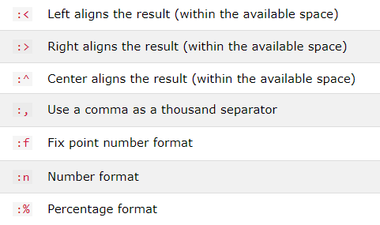
Some Common Format Specifiers
Using format specifiers is optional but makes your output more professional

Slide 22
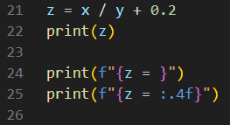

Edit then Run pemdas.py
You must type in this code
This type of placeholder prints the name of the variable as well as its value
①
③
This format specifier rounds to 4 digits to the right of the decimal
②
④

Slide 23
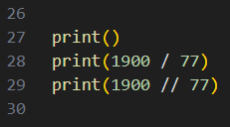

Edit then Run pemdas.py
You must type in this code
Calling print() with no arguments just displays a blank line
①
③
The double forward slash // is the integer (round down) division operator
⑤
②
④
⑥

Slide 24
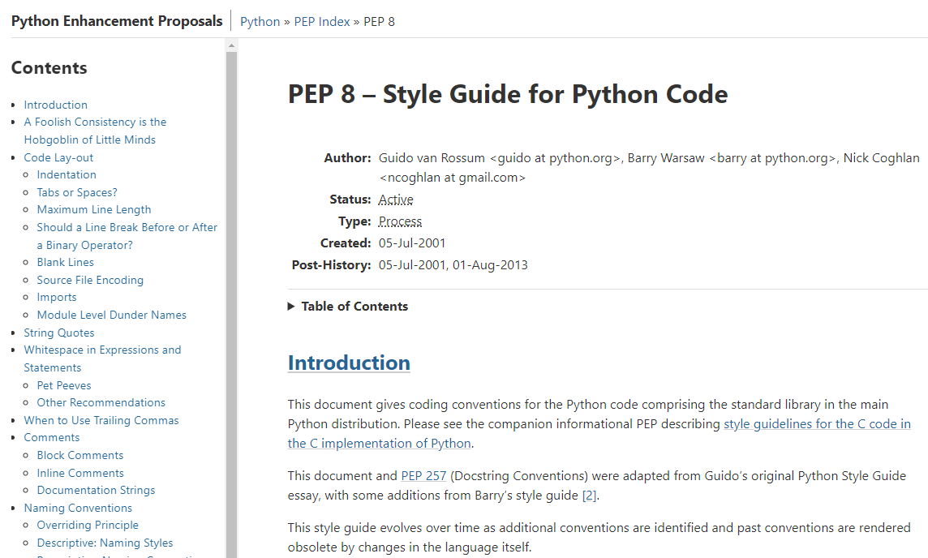
PEP 8 – Style Guide for Python Code
https://peps.python.org/pep-0008

Slide 25
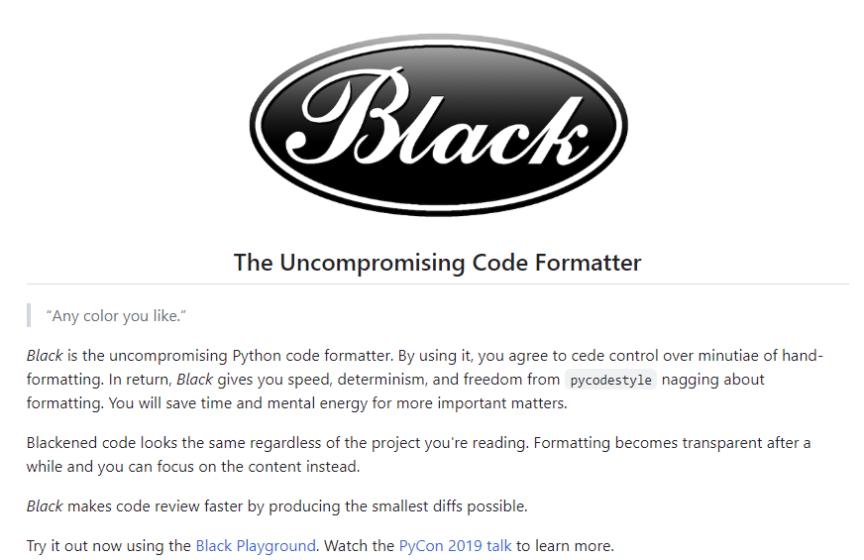
The black Package
https://github.com/psf/black

Slide 26
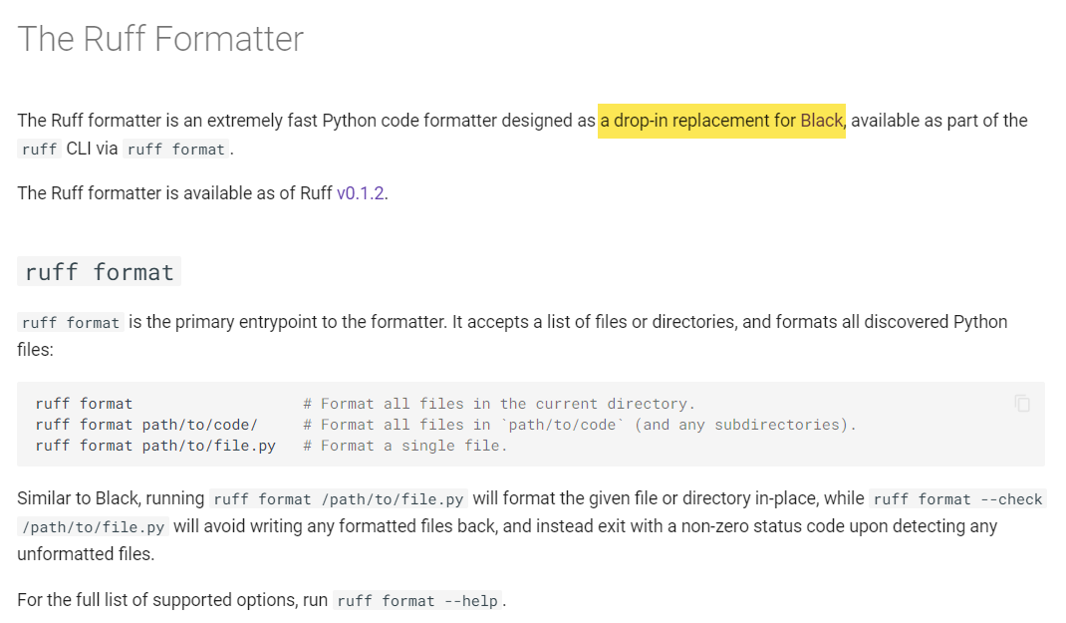
The Ruff Formatter
https://docs.astral.sh/ruff/formatter

Slide 27
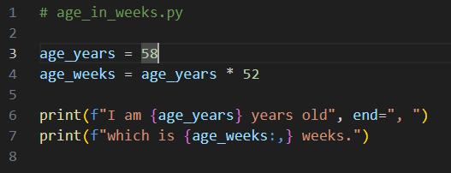
Edit then Run age_in_weeks.py
You must type in this code
①
②
③
④
Type your own age & notice the underscore
There are 52 weeks in a year
end=", " suppresses the line break
The :, format specifier puts a comma between every 3 digits
⑤

Slide 28


for loops
A for loop executes all the statements within its scope for each number within a given range
It is common to use the range() function to create the array of numbers passed into the for statement
The range() function takes up to three parameters: (start, stop, step)
The stop value is required but the start and step values are optional
The default value (if unspecified) for start is 0 and for step is 1
The range span is inclusive, exclusive: [start, stop)
$$⟹$$

Slide 29
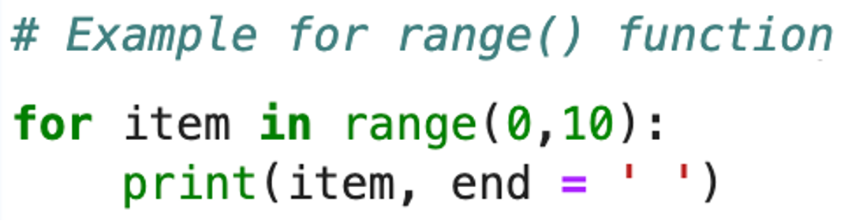

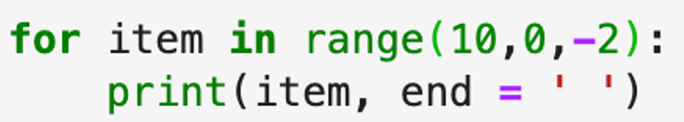

for loops

Slide 30
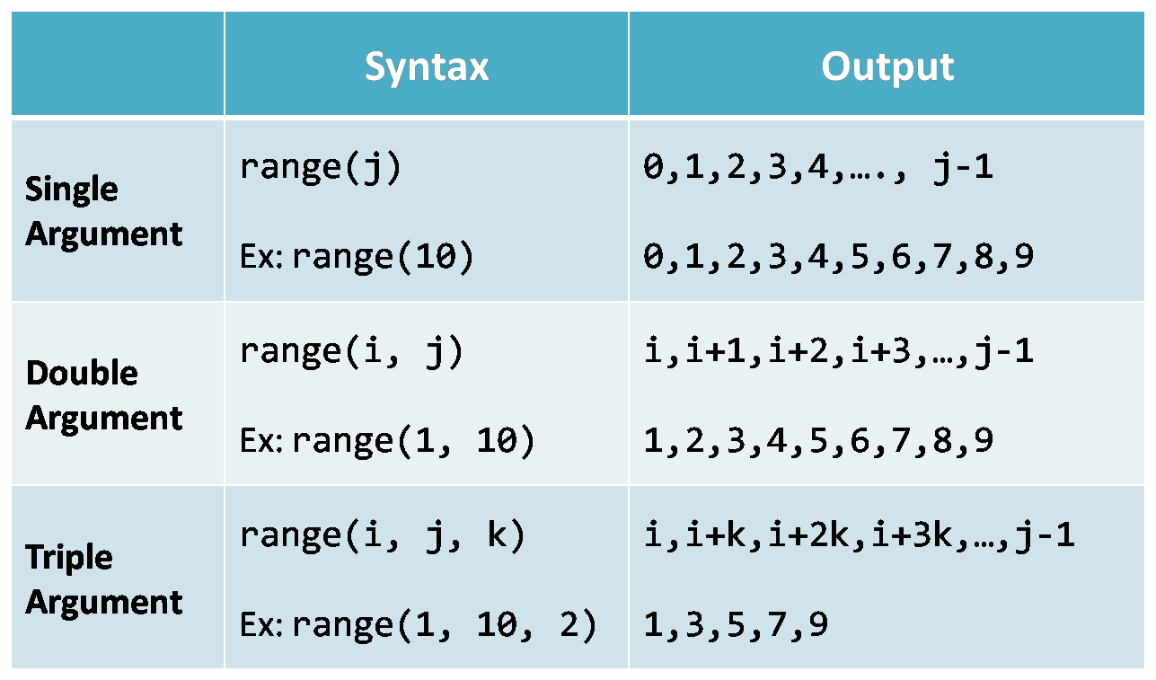
for loops

Slide 31
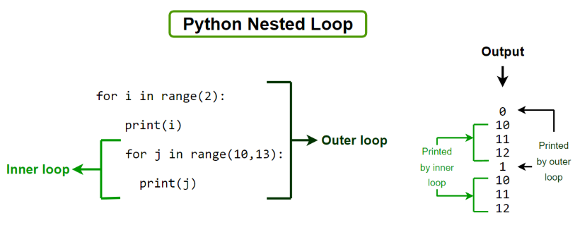
for loops

Slide 32
Temperature Conversion
Your scientist needs a program to calculate the correct Celsius temperature for a given Fahrenheit temperature
Display values between -44°F and 216°F inclusive
Your code should increment the temperature in steps of 4°F
Make the output look nice: display both the Fahrenheit and Celsius temperatures in right-justified columns, with two digits to the right of the decimal in each column
The research problem your scientist wants you to solve:
What is the one temperature that is the same
in both Fahrenheit and Celsius?

Slide 33
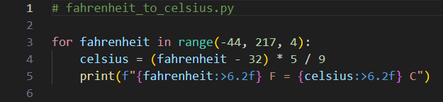
Edit fahrenheit_to_celsius.py
You must type in this code
①
②
③

Slide 34
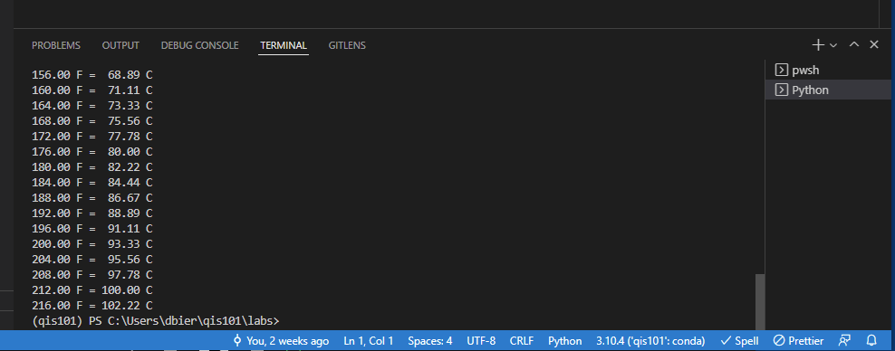
Run fahrenheit_to_celsius.py
Scroll the output window UP
What is the one temperature that is the same
in both Fahrenheit and Celsius?

Slide 35

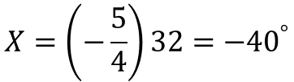




Temperature Equivalence
$$F=\frac{9}{5}C+32$$
$$X=\frac{9}{5}X+32$$
Temperature = Avg. KE
An intensive property that DOES NOT depend on how much material you have
$$X−\frac{9}{5}X=32$$
Heat Content = enthalpy
An extensive property that DOES depend on how much material you have
$$\frac{5}{5}X−\frac{9}{5}X=32$$
$$−\frac{4}{5}X=32$$
$$X=\left(−\frac{5}{4}\right)32={−40}^{°}$$

Slide 36
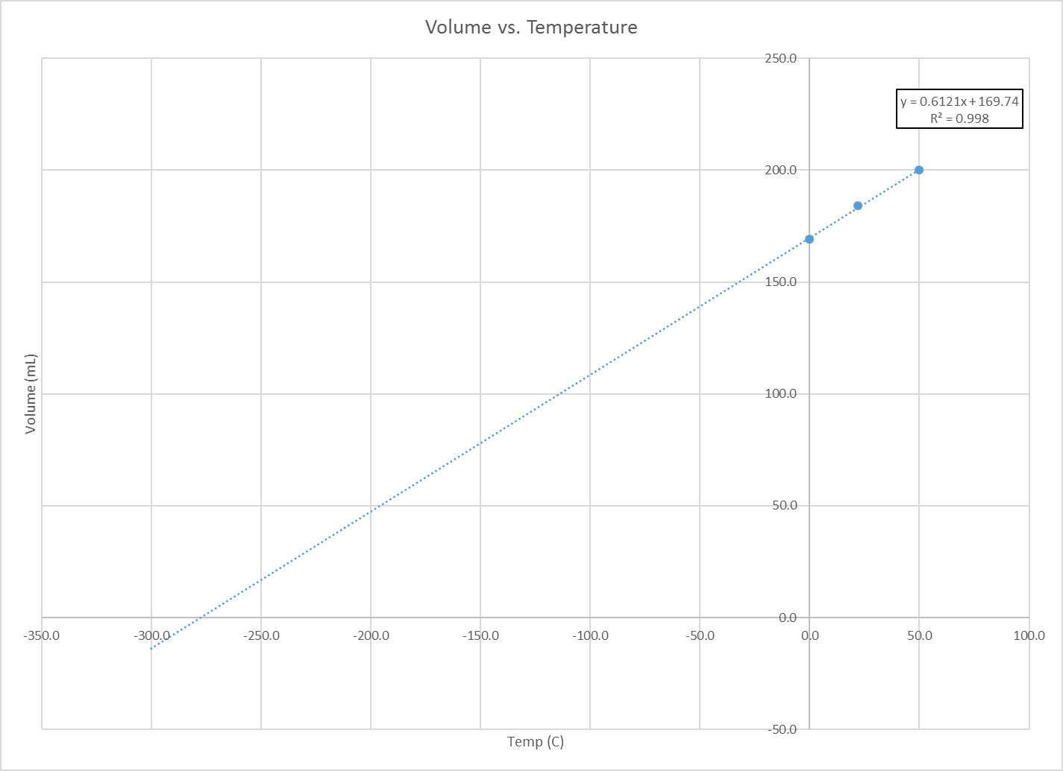
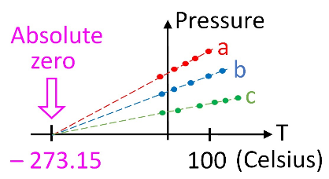
How did we calculate absolute zero in 1779? (PV = nRT)
Johann Heinrich Lambert (1779)
Jacques Charles (1787)
Joseph Louis Gay-Lussac (1802)
“Air Thermometer”

Slide 37
Session 02 – Now You Know…
Python respects PEMDAS operator precedence
How to define variables in Python (snake_case)
How to use print() to show variable values on screen
How to use f-strings and print format specifiers (replacement fields) to give your output a more professional appearance
How to use for loops with a range() function

Slide 38
TASK 02
Update the code in age_in_seconds.py to calculate and display your age in both years and seconds

